Slide 1
Project name::.
Load runner

Slide 2
Team members::.

Slide 3
Mohamed araby
Mohamed sabry
Mohamed Saeed
Mohamed Reda
Mohamed Abd elsamad
Mohamed Abd elgaffar
Mohamed Abd elbasset

Slide 4
Introduction::.
In this project , we are create a game which called load runner .
This game considered entertainment for the user .
This game contain the following :-
1- player
2- zombie
3- coins
4-stairs
5- bricks

Slide 5
The program
in this program we want to make the user happy and Feel the suspense and excitement .
When the user run the game , he should take or eat all coins to move the next level , but He must be wary of enemies or zombies.
When the user eat all coins as fast as the current level will finished and move to next level after eat the last coin .
If the player died , this program enable the user to restart the game or play this game again .

Slide 6
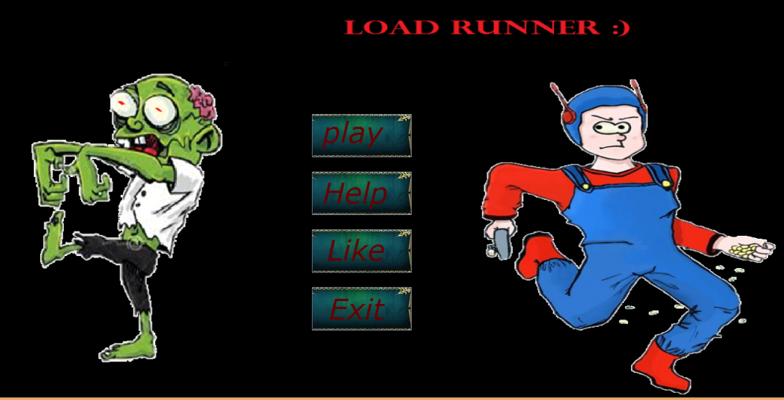
Login screen

Slide 7
Login screen:- the login screen contain 4 options : 1- Play 2-Help 3- Like 4- Exit

Slide 8
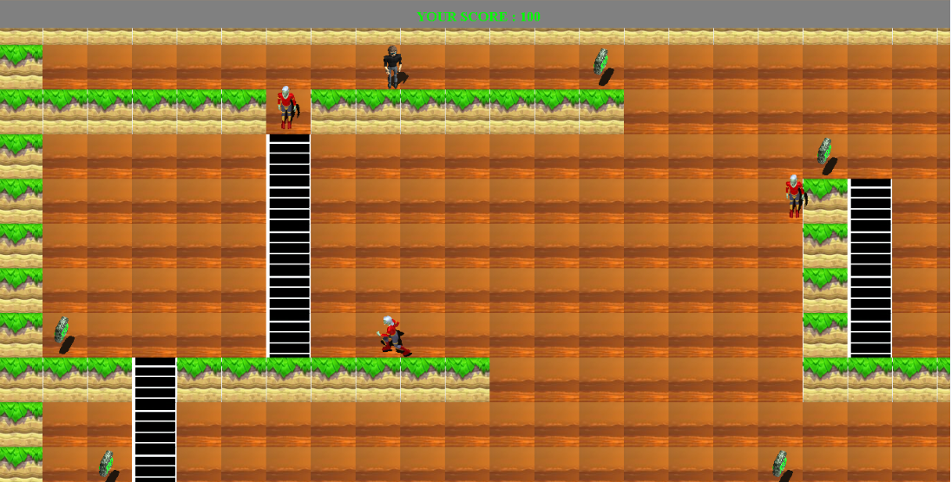
Login screen if the user select the play button , the game will start , and the program will display the environment of the game (first level ).

Slide 9
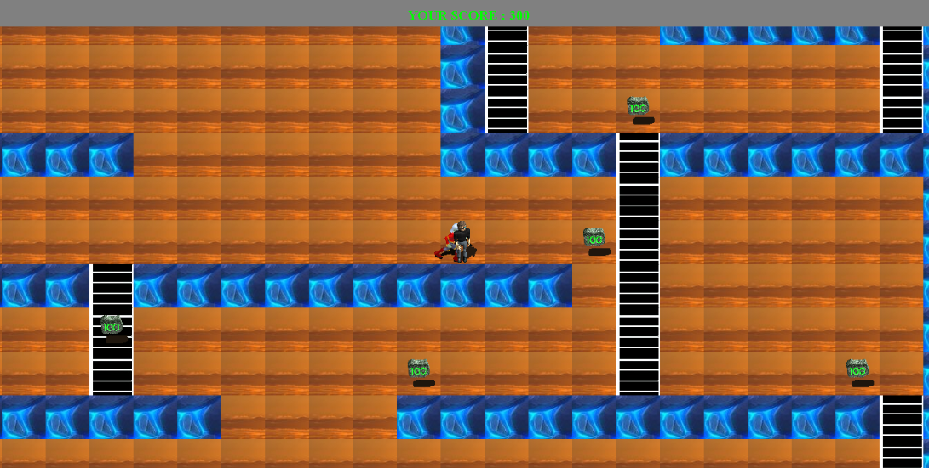
Login screen when the user finish the first level , the program will move to next level .

Slide 10
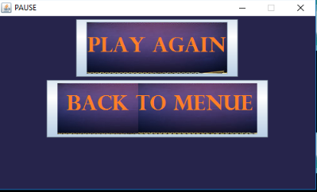
Login screen :- when the user finish level 2 , the program will move to next level and so on ….. If the user died , the program enable the user to play again and show this frame :-

Slide 11
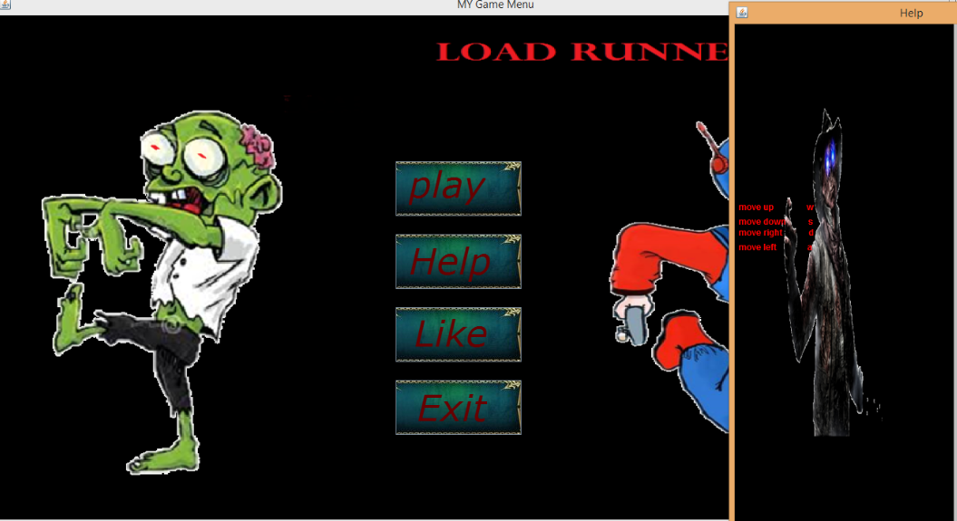
Login screen
In this game , we are introduce option help the user if he don’t know how to play the game .
If the user select Help button , the frame will displayed containing how to move the player .

Slide 12
Login screen if the user select the Exit button , the program or game will end .

Slide 13

The mechanism of player :-
In this game , we move the player by the button (W , S , D , A ).
W for up .
S for down .
D for right .
A for left .
When the user want to move right , he should press the D button from keyboard .

Slide 14

The mechanism of player :- When the user want to move left , he should press the A button from keyboard .

Slide 15


The mechanism of player :- When the user want to move up , he should press the W button from keyboard . When the user want to move down , he should press the S button from keyboard .

Slide 16




The mechanism of zombie :- in this game , the player move all anywhere (all place ) to earn the coins , at the same moment the zombies move behind the player to kill him . Up down left right

Slide 17
The mechanism of game in this game , we are introduced a trick . If the player want to kill the zombie , he should press the Q , R from the keyboard . If the user press Q the brick behind him will disappear . If the user press E the brick forward him will disappear

Slide 18








The coins When the player move at the coin will disappear , this means that the player eat the coin , and the score will change up by 100 . This picture show that the coins move circularly .

Slide 19

The stairs
The player use the stairs to move around the level (up – down ) to collect all coins .

Slide 20


The graphics
In this program , we are used tiles to draw the levels .
We are used integer numbers that represented the graphics .
This numbers is (0 , 2 , 4 ).
0 represent spaces .
2 represent rocks .
4 represent stairs .

Slide 21
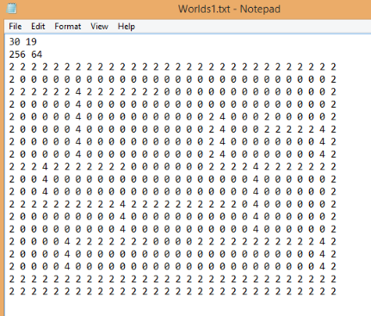
The graphics
To draw level 1 :-

Slide 22
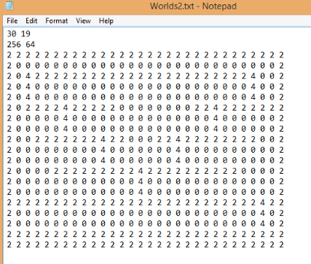
The graphics
To draw level 2 :-

Slide 23
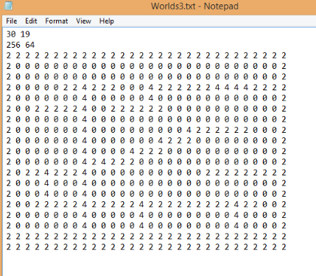
The graphics
To draw level 3 :-

Slide 24
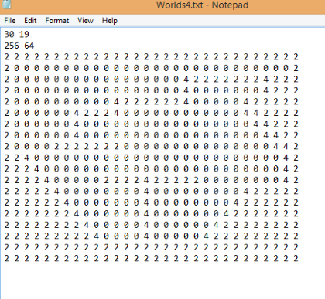
The graphics
To draw level 4 :-

Slide 25
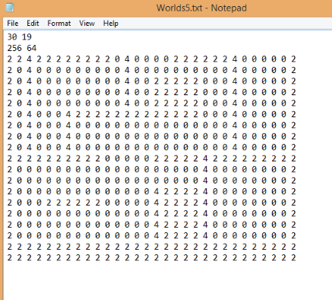
The graphics
To draw level 5 :-

Slide 26
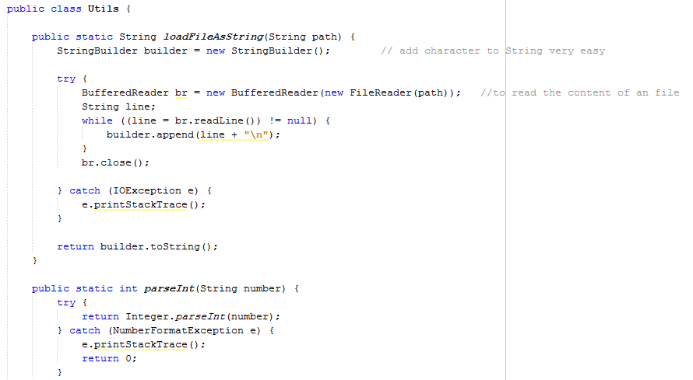
The graphics
The program treat with this integer as a character , then take it and convert this number to integer and call the number from tile that equal this number and print it at the frame .
This is the code :-

Slide 27
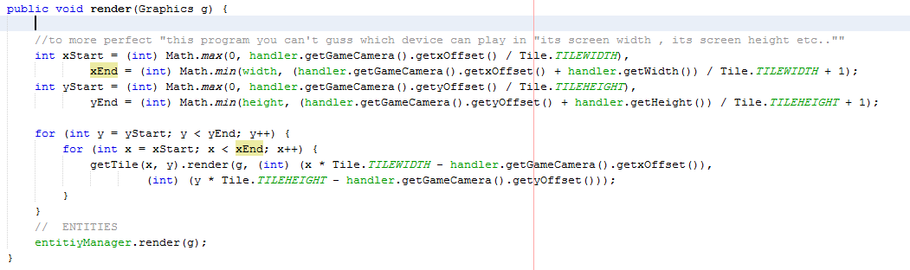
The camera
In this section , we are explain the role of camera .
We need the camera to move with the player to cover or show all the level .
This camera is very important , because the player move in all the level ,so we need the camera to show the player .
This is the code which make camera moving with all its precision.

Slide 28
Conclusion
At the load runner game , we are introduced the game contain many action and suspense .
The user will move the player by buttons all around the level to collect all coins , 1 coin = 100 .
When the player collect all coins , it will move to next level an so on.
If the zombie kill the player , the user able to play again .

Slide 29
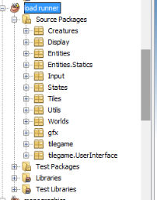
Conclusion
This game depending on creating classes .
We are create many classes which each class do its job .
There are many package which each contain number of classes .

Slide 30
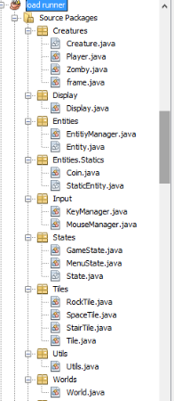
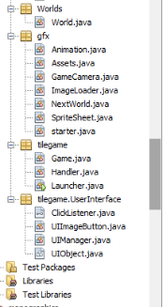
Conclusion
This is the classes in the program :-

Slide 31


Thank You for your attention
..
31

